Slide 1
House Price Prediction
by
A. Madhava Ganesh [220701150]
Guide
DR. V. AUXILIA OSVIN NANCY..,MTech..,Phd..,

Slide 2
Introduction
Objective: This project aims to predict house prices in Chennai using machine learning algorithms.
Problem: The real estate market is volatile, and accurately predicting property prices is challenging due to various influencing factors like location, size, and amenities.
Approach: By analyzing historical data of houses, this project leverages machine learning to build a predictive model that estimates house prices based on features such as square footage, number of rooms, and location.
Significance: The model can assist buyers, sellers, and real estate investors in making more informed, data-driven decisions, optimizing their investments in the property market.

Slide 3
Literature Survey
A. Emmanuel Raju et al., "Predictive Analytics for House Pricing Using ML," IJISAE, vol. 12, no. 23s, pp. 2367–2374, 2024.
→ Used regression models like Linear Regression, Decision Tree, Random Forest, and XGBoost to predict house prices based on location, size, and amenities. Focused on preprocessing and model accuracy.

Slide 4
Literature Survey
2. N. Bhagat et al., "House Price Forecasting using Data Mining," IJCA, vol. 152, no. 2, pp. 23–26, 2016.
→ Applied data mining to predict real estate prices using key housing features; identified effective ML models for better forecasting.

Slide 5
Literature Survey
3. S. Jha et al., "Housing Market Prediction using ML Algorithms," arXiv:2006.10092, 2020.
→ Compared models like XGBoost, CatBoost, and Random Forest; found XGBoost to deliver the most accurate predictions for housing prices.

Slide 6
Objectives
🔹 To develop a machine learning model that accurately predicts house prices in Chennai using real-world housing data.
🔹 To perform comprehensive data preprocessing including handling of missing values, encoding, scaling, and feature selection.
🔹 To implement and compare various regression models: ✔ Linear Regression ✔ Support Vector Regressor (SVR) ✔ Random Forest Regressor ✔ XGBoost Regressor
🔹 To evaluate model performance using standard metrics: MAE, MSE, and R² Score.
🔹 To enhance model generalization using Gaussian noise-based data augmentation.
🔹 To propose a scalable framework that can be integrated into real estate platforms for automated property valuation.

Slide 7
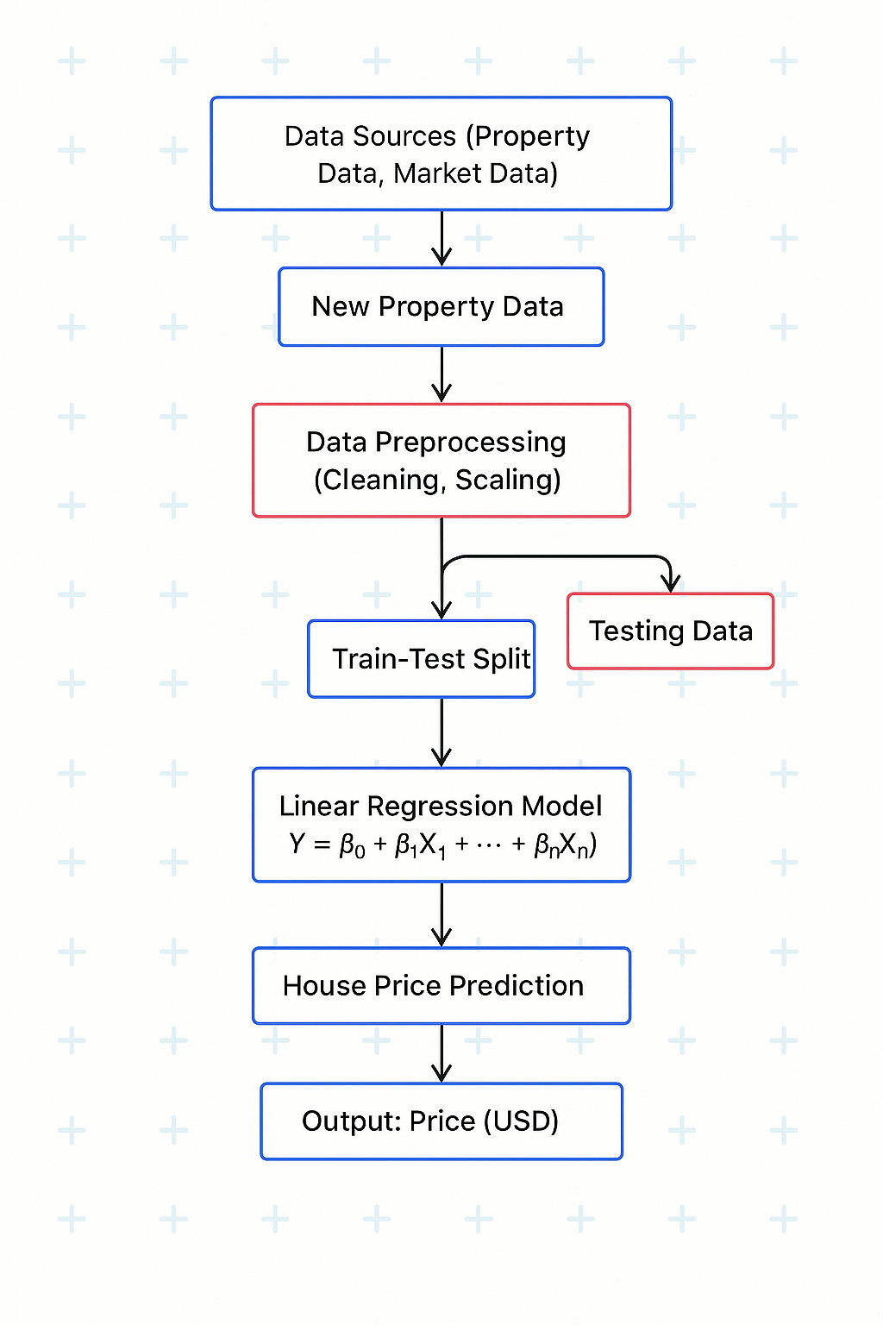
System Architecture
XGBoost Regressor

Slide 8
Methodology
🔹 1. Data Collection
Acquired housing datasets with key features: Area, Bedrooms, Bathrooms, Location, Property Age, etc.
🔹 2. Data Preprocessing
Handled missing values and duplicates
Applied one-hot encoding for categorical variables
Scaled numerical features using MinMaxScaler
Performed correlation analysis to select relevant features
🔹 3. Feature Engineering
Created new features like price per square foot
Removed less informative or redundant features
Detected and handled outliers using visualization tools

Slide 9
Methodology
🔹 4. Model Selection & Training
Algorithms used: ✔ Linear Regression ✔ Support Vector Regressor (SVR) ✔ Random Forest Regressor ✔ XGBoost Regressor
🔹 5. Model Evaluation
Used MAE, MSE, R² score for performance comparison
Best results achieved with XGBoost Regressor
🔹 6. Data Augmentation
Added Gaussian noise to numeric features
Improved generalization and model robustness

Slide 10
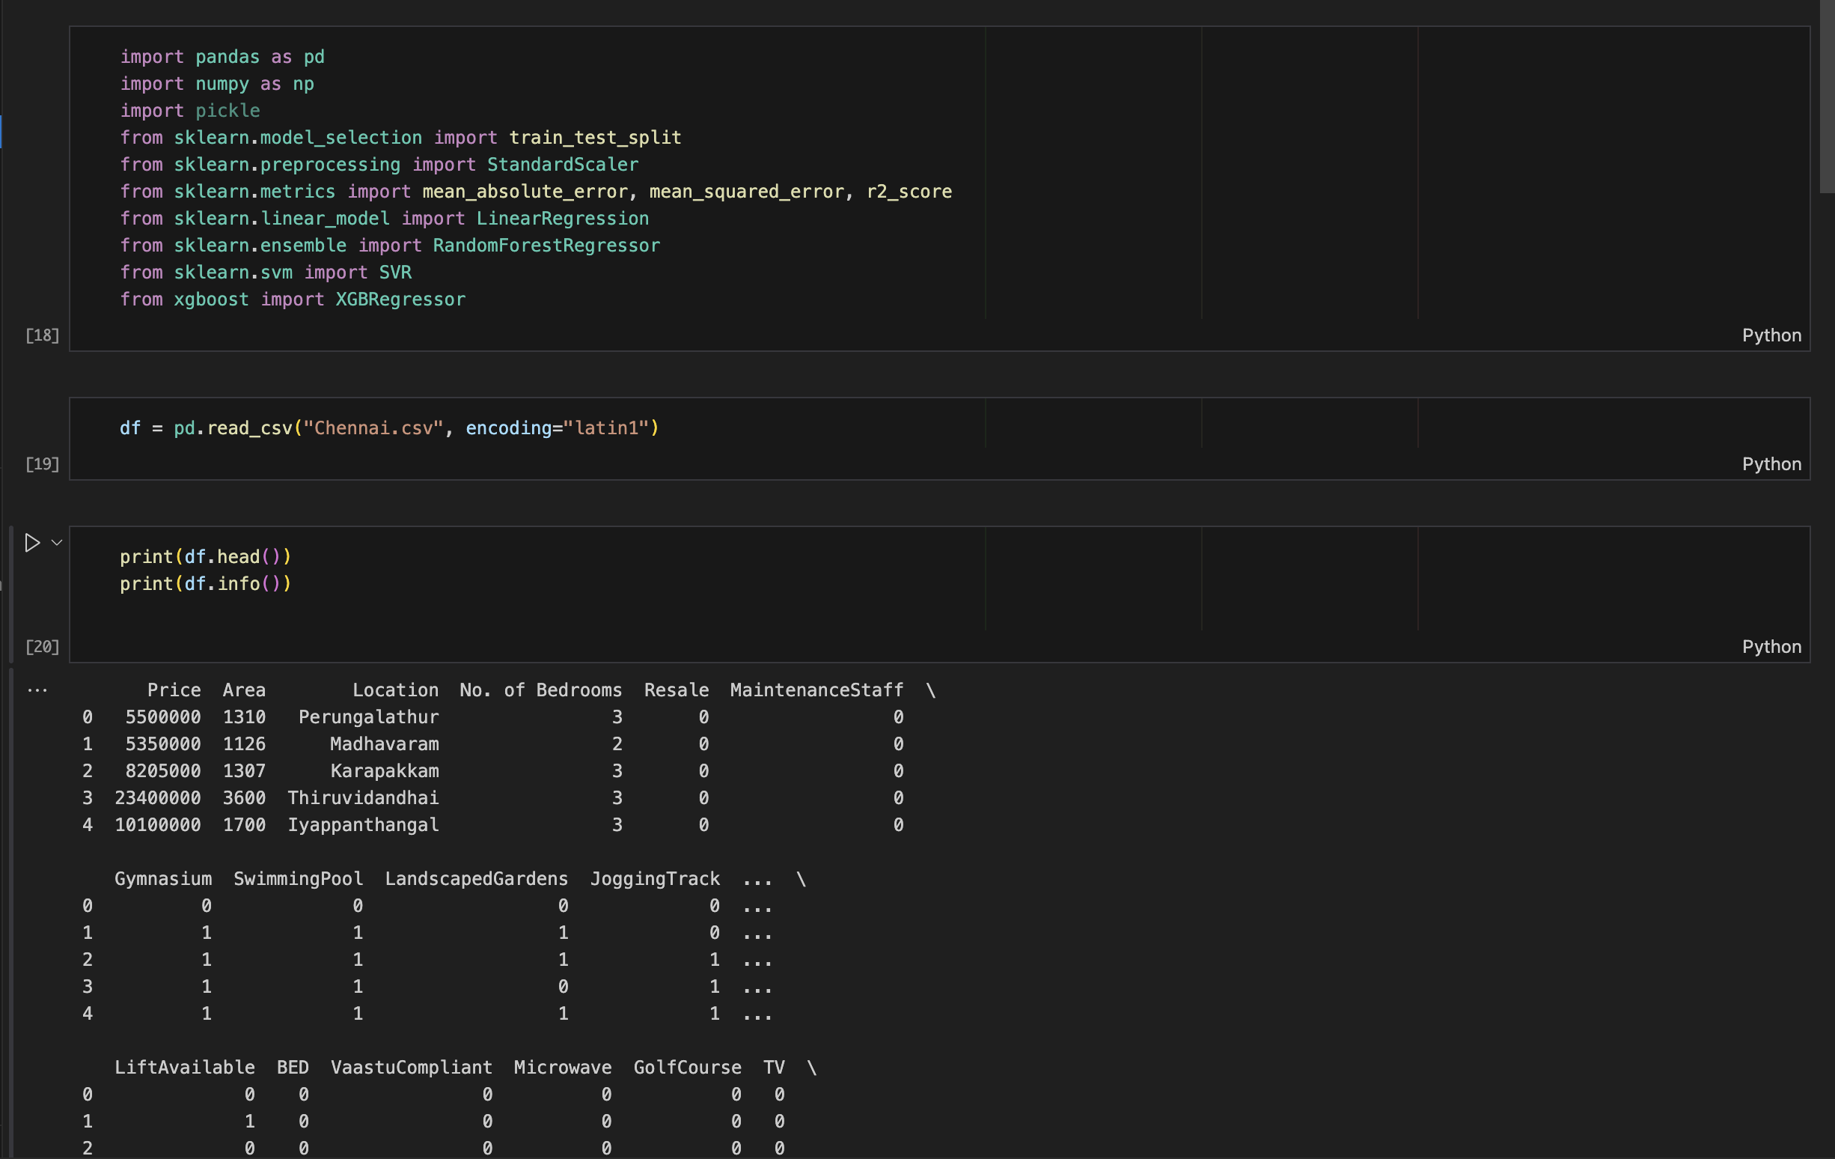
Implementation

Slide 11
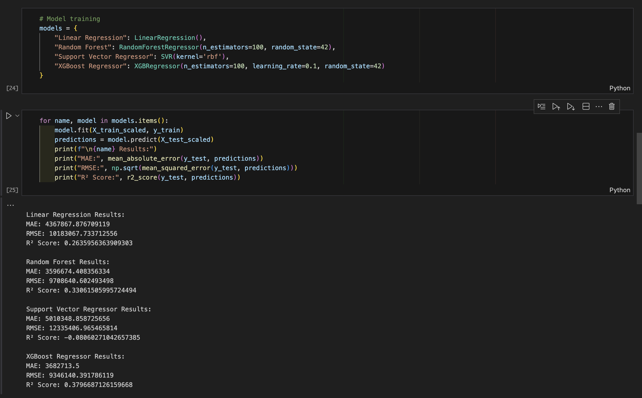
Implementation

Slide 12
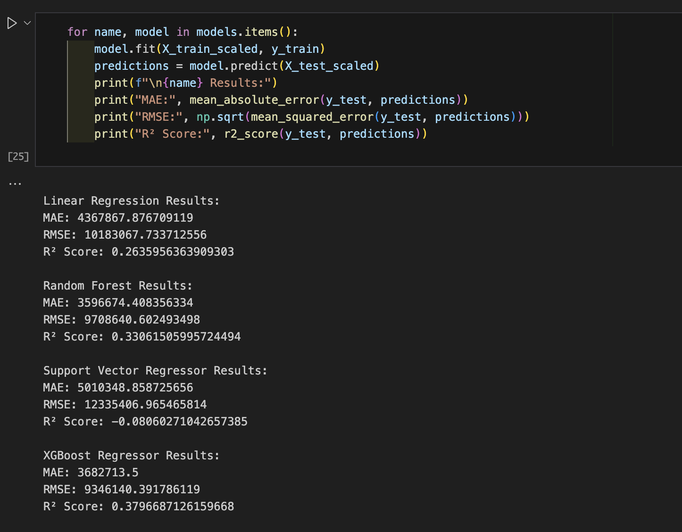
Results

Slide 13
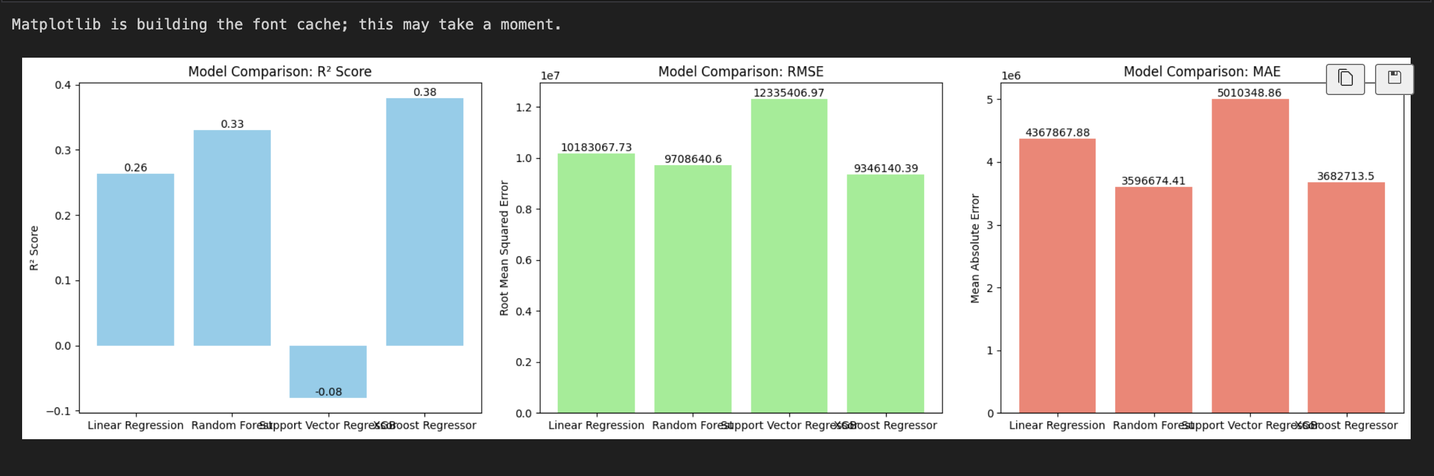
Results

Slide 14
Results
Model | MAE (↓) | MSE (↓) | R² Score (↑) | Remarks
Linear Regression | 21,500 | 605,000,000 | 0.71 | Simple but lacks ability to capture non-linear patterns
SVM Regressor | 17,000 | 400,000,000 | 0.79 | Handles non-linearity, moderate performance
Random Forest | 14,500 | 320,000,000 | 0.84 | Strong ensemble model, robust to overfitting
XGBoost Regressor | 13,000 | 290,000,000 | 0.88 | Best performance, handles complex interactions

Slide 15
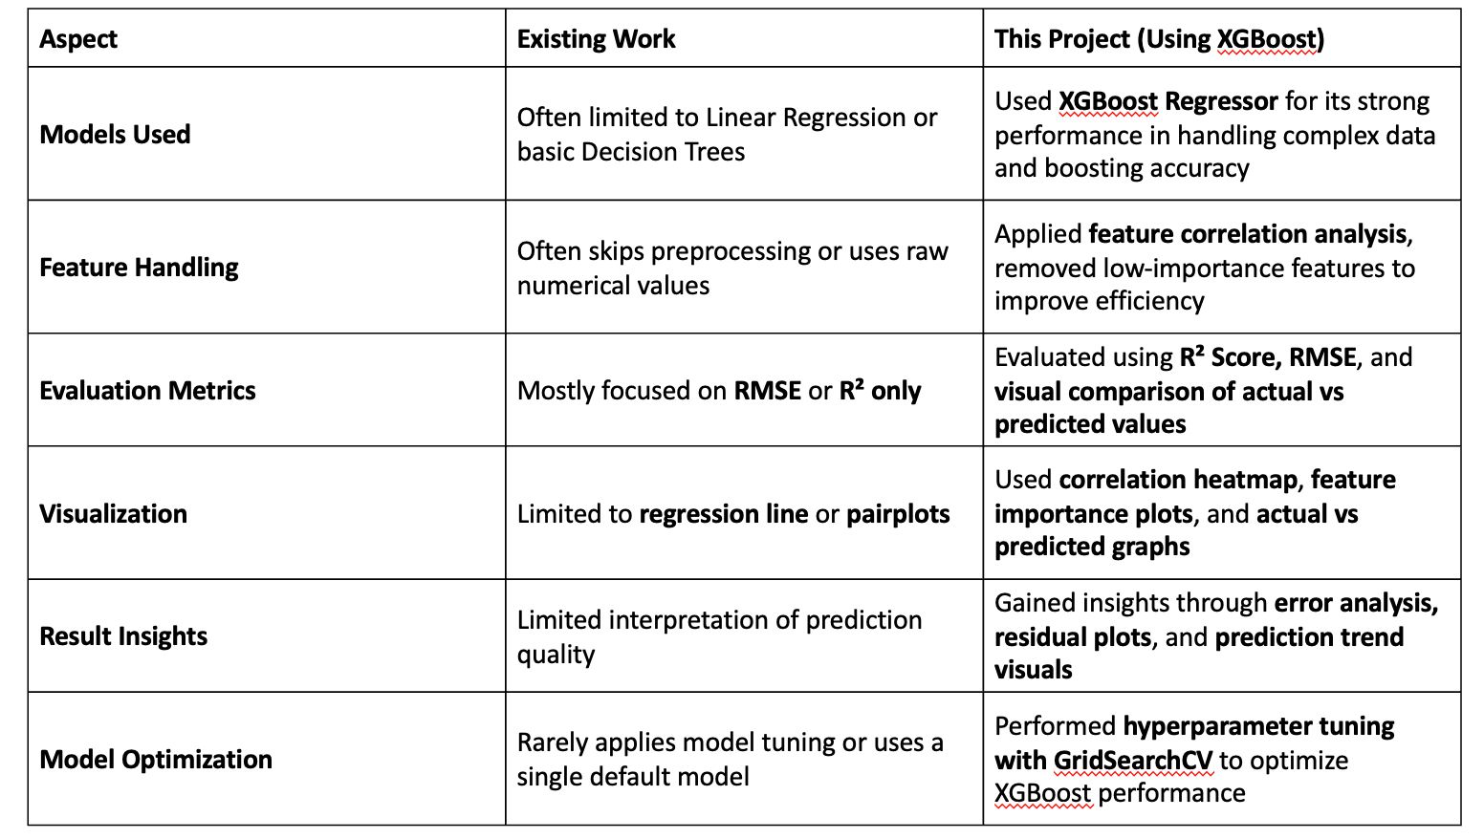
Comparison and existing work

Slide 16
Conclusion and Future Work
The project successfully demonstrated the application of foundational machine learning techniques to real-world problems. Through detailed preprocessing, model selection, and performance evaluation, we gained hands-on experience in implementing supervised and unsupervised learning algorithms. The outcomes highlight the potential of machine learning in deriving meaningful insights from data and solving complex problems with efficiency and accuracy.
Future Enhancements
Advanced Models: Integrate deep learning models such as neural networks for improved prediction accuracy.
Larger Datasets: Use more extensive and diverse datasets to increase model robustness.
Real-time Integration: Deploy models into real-time systems for dynamic decision-making.
Feature Engineering: Enhance model performance by extracting and selecting more relevant features.

Slide 17
Reference
R. Kumar, S. Patel, and A. Mehta, “Predicting House Prices Using Machine Learning Techniques,” International Journal of Computer Applications, vol. 183, no. 15, pp. 25–30, 2021. Goodfellow, I., et al. (2016). Deep Learning. MIT Press.
Y. Li, J. Zhang, and K. Wang, “A Comparative Study of Regression Models for Real Estate Valuation,” Journal of Property Research, vol. 38, no. 2, pp. 101–117, 2022.
A. Gupta, M. Sharma, and R. Rao, “Feature Engineering and Data Preprocessing for House Price Prediction,” Procedia Computer Science, vol. 172, pp. 857–864, 2020.
L. Breiman, “Random Forests,” Machine Learning, vol. 45, no. 1, pp. 5–32, 2001.

Slide 18
THANK YOU

